Slide 1
CMP203 Graphics Programming
Model loading

Slide 2
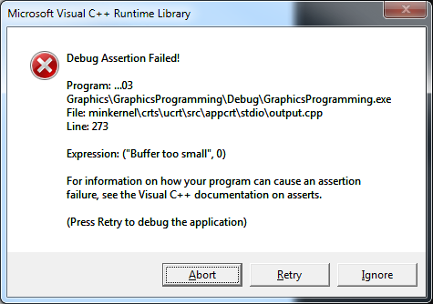
Before we get started
People working outside the lab have been getting this error

Slide 3


Before we get started
The FPS counter is experiencing a buffer overflow
Bad
Increase size of the char array to fix this
In Scene.h

Slide 4
This Week
Model Formats
How data is stored
Model loader
Simple example

Slide 5
Model Formats
Data for 3D models needs to be represented in a transportable file format
Must contain all the info we need for Vertices, Texture Coordinates, Normals, Materials and animation data
We must have a way of creating models then converting them to this format
We must also have a way of reading the file and converting it into data that the Graphics API can deal with
Specifying all the vertices by hand will get out of hand
Load them in from a file, requires creating a model class
Vertex arrays make up a large part of model loading

Slide 6
Model Formats
Within Games Companies
Sometimes a format cannot be found that support the features a company wants
Extra model information may be required for the type of game
Destructible models
Special face flags
Weapon tags
Animation data etc
Games companies can develop their own format for models and even loaded levels
Although these editors are not commonly available outside the company

Slide 7
Common file types
There are a large number of different file formats for 3D models
Object (.obj)
Open file format
No animation
Most things can load this
Most prolific model format
Max and Maya (.max and .mb)
Unity can load and convert these (Maya but not Max)
Most other engine requires them to be exported to a different format

Slide 8
Common file types
MD2 & 3
Quake 2 and 3
Handle key framed animations
SMD
Half life
One of the first to use skeletal animation

Slide 9
Common file types 2
Collada (.dae)
COLLAborative Design Activity
Aimed at being an intermediate file format for interactive 3D applications
DAE = Digital Asset Exchange
XML based
FBX (.fbx)
Another intermediate file format
Widely used
DirectX 3D model (.x)
Easy to load
Not the best
Deprecated

Slide 10
Milkshape 3D
3D modelling Software
Created by chUmbaLum sOft in Switzerland (one man development team)
Originally created to allow people to create new Half-life models
Also contains tools and functionality for animation
Supports importing and exporting in formats for many popular games and modelling packages
Half-life, Quake, Unreal, Max Payne, Sims etc
3D Max, AutoCad, Direct X, Maya etc
Also has its own Native model format

Slide 11
Model loading
We will be loading .obj models
A detail look at the .obj layout
Sorting the data
Rendering
To handle all this will create a model class

Slide 12
OBJ File Format
The file points to a material file if there is one
The lists all the vertices
v 0.000000 2.933333 -0.000000
v 0.000000 -2.933333 -0.000000
v 0.382877 -2.908238 -0.000000
…
…
…
# 333 vertices
End with a count of vertices

Slide 13
OBJ File Format
Then lists all the texture coordinates
vt 0.000000 0.000000
vt 0.000000 0.041667
vt 0.041667 0.041667
…
…
…
# 400 texture vertices
Ending with a count of texture coordinates

Slide 14
OBJ File Format
Then a list of all the normals
vn 0.000000 -1.000000 0.000000
vn 0.152143 -0.988359 -0.000000
vn 0.126070 -0.991446 0.033780
…
…
…
# 333 vertex normals
Ending with a count of normals

Slide 15
OBJ File Format
Which material to use
List of faces
f 2/1/1 3/2/2 4/3/3
f 1/4/4 532/5/5 531/6/6
f 2/7/1 4/3/3 5/8/7
…
…
…
# 700 faces
Ending with number of triangles
Faces = v/t/n v/t/n v/t/n

Slide 16
Obj loading
Some useful information
Vertices SHOULD BE stored in a counter-clockwise order by default
Worth checking before undertaking model loading
I will provide a model or two for testing
Not all models are created equally
Some will be built for 3D art and therefore may contain quads
The loader we will build will require triangles
It could be modified/update to handle quads
Models for 3D art are usually higher detail than required for real time rendering

Slide 17
OBJ loading
Model class
Handles model loading and texture loading
Vector3 class
The one we used for the camera
Will be used within the model loader

Slide 18
Model class in detail
Functions
Load(model filename, texture filename)
Calls load model and load texture
Render()
Renders the model
LoadModel (model filename)
Loads the model file and parses the data
LoadTexture (texture filename)
Runs texturing loading code
Stores texture as part of the model

Slide 19
Model class in detail
Private variables
m_vertexCount
Stores the number of vertices in the model
GLuint texture
Model class loads and stores it’s own texture
Vector<float> vertex, normals, texCoords
Vectors for storing processed and sorted model data
These are for you to use

Slide 20
Load model ()
Break this down into steps
First
Attempted to load file
Check if file exists
Parse the file
Broken down by vertex, texture, normal and face data
Here we will get the important data based on the line prefix
If the line is blank skip ahead to the next line
If “v” store vertex data
If “vn” store normal data
If “vt” store texture coordinate data

Slide 21
Load model ()
bool Model::loadModel(char* filename)
{
vector<Vector3> verts;
vector<Vector3> norms;
vector<Vector3> texCs;
vector<unsigned int> faces;
FILE* file = fopen(filename, "r");
if (file == NULL)
{
return false;
}
while (true)
{
char lineHeader[128];
// Read first word of the line
int res = fscanf(file, "%s", lineHeader);
if (res == EOF)
{
break; // exit loop
}

Slide 22
Load model ()
else // Parse
{
if (strcmp(lineHeader, "v") == 0) // Vertex
{
Vector3 vertex;
fscanf(file, "%f %f %f\n", &vertex.x, &vertex.y, &vertex.z);
verts.push_back(vertex);
}
else if (strcmp(lineHeader, "vt") == 0) // Tex Coord
{
Vector3 uv;
fscanf(file, "%f %f\n", &uv.x, &uv.y);
texCs.push_back(uv);
}
else if (strcmp(lineHeader, "vn") == 0) // Normal
{
Vector3 normal;
fscanf(file, "%f %f %f\n", &normal.x, &normal.y, &normal.z);
norms.push_back(normal);
}

Slide 23
Load model()
Faces is a little more tricky
Faces provides the indices of vertices, texture coordinates and normals
f 2/1/1 3/2/2 4/3/3
v/t/n v/t/n v/t/n
Not using a Vector3
Int vector
Could put these in separate int vector for each type of index

Slide 24
Load model ()
else if (strcmp(lineHeader, "f") == 0) // Face
{
unsigned int face[9];
int matches = fscanf(file, "%d/%d/%d %d/%d/%d %d/%d/%d\n", &face[0], &face[1], &face[2],
&face[3], &face[4], &face[5],
&face[6], &face[7], &face[8]);
if (matches != 9)
{
// Parser error, or not triangle faces
return false;
}
for (int i = 0; i < 9; i++)
{
faces.push_back(face[i]);
}
}
}
}

Slide 25
What’s missing
Step 3
What you need to do
Process the stored model data
It’s loaded from the file but not in a format we can render
Fill out the render function
The function exists, but is empty
This depends on how you process the model data

Slide 26
Process the data pseudo-code
Loop for all the face data
Use first face value
Vertex index
Store x, y, z for vertex in another vector
Use second face value
Texture coordinates
Store u, v in texCoord vector
Use third face value
Normals
Store x, y, z in normals vector
Increment loop by 3

Slide 27
Render ()
This depends how you have processed the model
The method just discussed builds a vertex array without a index array
Using code from a previous week we can easily render these arrays

Slide 28
Adding to our scene
Scene3D.h
#include "Model.h"
Model model;
Scene3D.cpp
During initialisation / Scene constructor
model.load("Models/sphere.obj", "Models/brick.jpg");
In Render()
model.render();

Slide 29
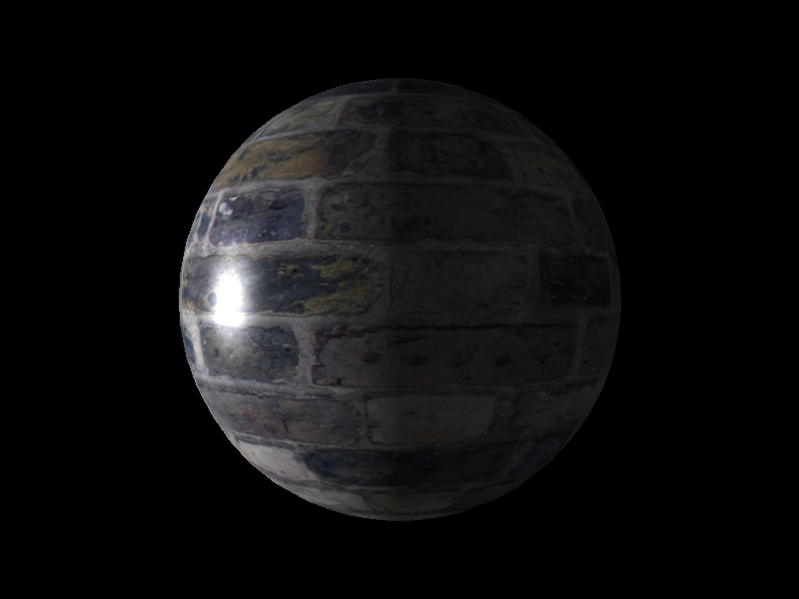
Results

Slide 30
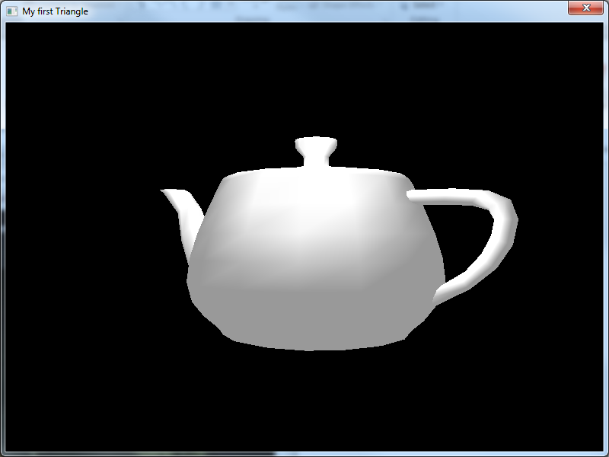

Slide 31
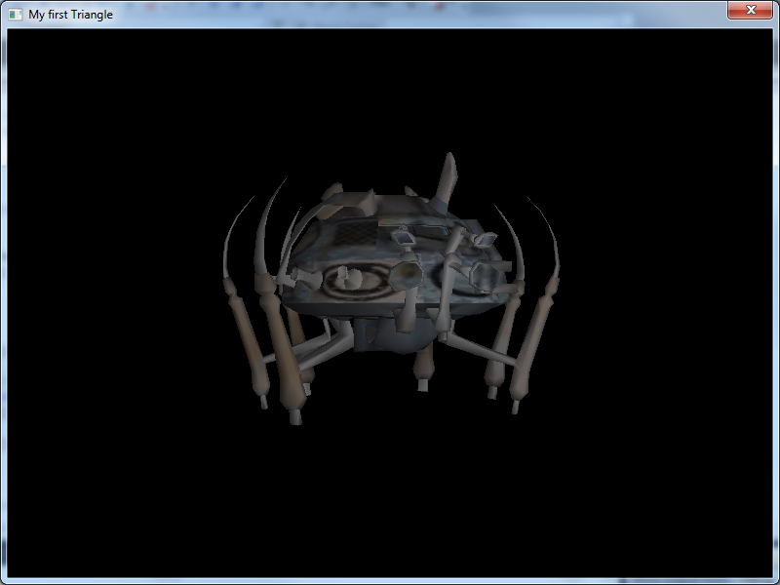

Slide 32
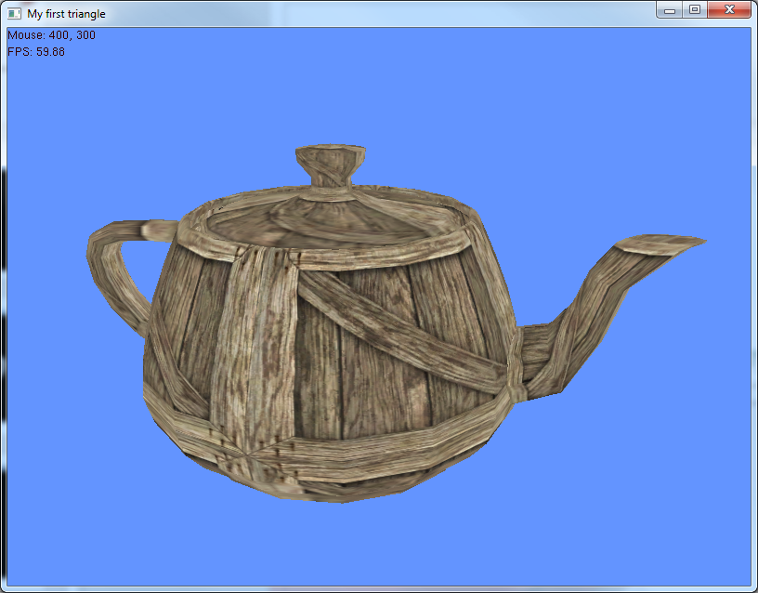

Slide 33
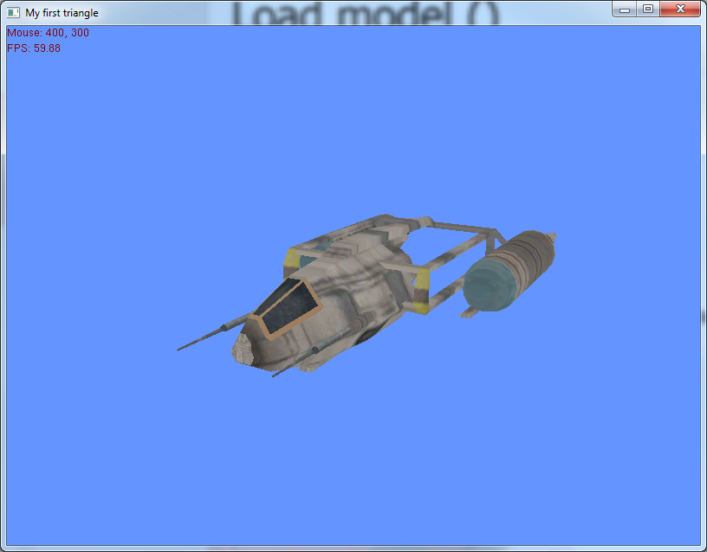

Slide 34
Warnings
Exporting to .obj
Triangulate
Things to watch for
Missing normals or texture coordinates
Faces having four values instead of three
Can create a model loader to handle these issues
Things you may want to look into
It’s possible to get the texture file for the model data and load it that way
mtl files

Slide 35
Recommended Reading
Focus on 3D models – Evan Pipho
Covers many popular model formats
Quake2/3
Milkshape
3Ds
Half-life

Slide 36
The labs
Build and test an OBJ loader
Add the provided code to an application
Complete the provided code
Process the model data
Write a render function
Test with other models
Resources
Open Game art
http://opengameart.org/
Turbo Squid
http://www.turbosquid.com/
Requires account, and search for free
TF3DM
http://tf3dm.com/

